Slide 1

BOEING STOCK VOLATILITY
BY: EVAN NUSSBAUM SPRINGBOARD CAPSTONE

Slide 2
What is Volatility?
Historical volatility (HV) is the volatility experienced by the underlying stock, stated in terms of annualized standard deviation as a percentage of the stock price. Historical volatility is helpful in comparing the volatility of one stock with that of another stock or to the stock itself over a period.
Implied volatility is often interpreted as the market’s expectation for the future volatility of a stock. Implied volatility can be derived from the price of an option. Specifically, implied volatility is the expected future volatility of the stock that is implied by the price of the stock’s options.
Higher volatility corresponds to a higher probability of a declining market, while lower volatility corresponds to a higher probability of a rising market. Investors can use this data on long term stock market volatility to align their portfolios with the associated expected returns.

Slide 3
Methodology
Obtain the data and wrangle it to make sure the data is cleaned up
Do an Exploratory Data Analysis to make insights and conclusions in various ways
Use that data make a time-series analysis
Build predictive Machine Learning models
Attempt to make a useful recommendation to a client or organization

Slide 4
Where is my data coming from?
Quandl is a marketplace for financial, economic, and alternative data delivered in modern formats for today’s analysts.
Found the Boeing stock info that includes closing price, volume, high, low etc.
Found the Boeing option info that includes historical and implied volatility at various different maturity lengths
Merge the two datasets to see it as one
Remove any null values to have cleaned up data

Slide 5
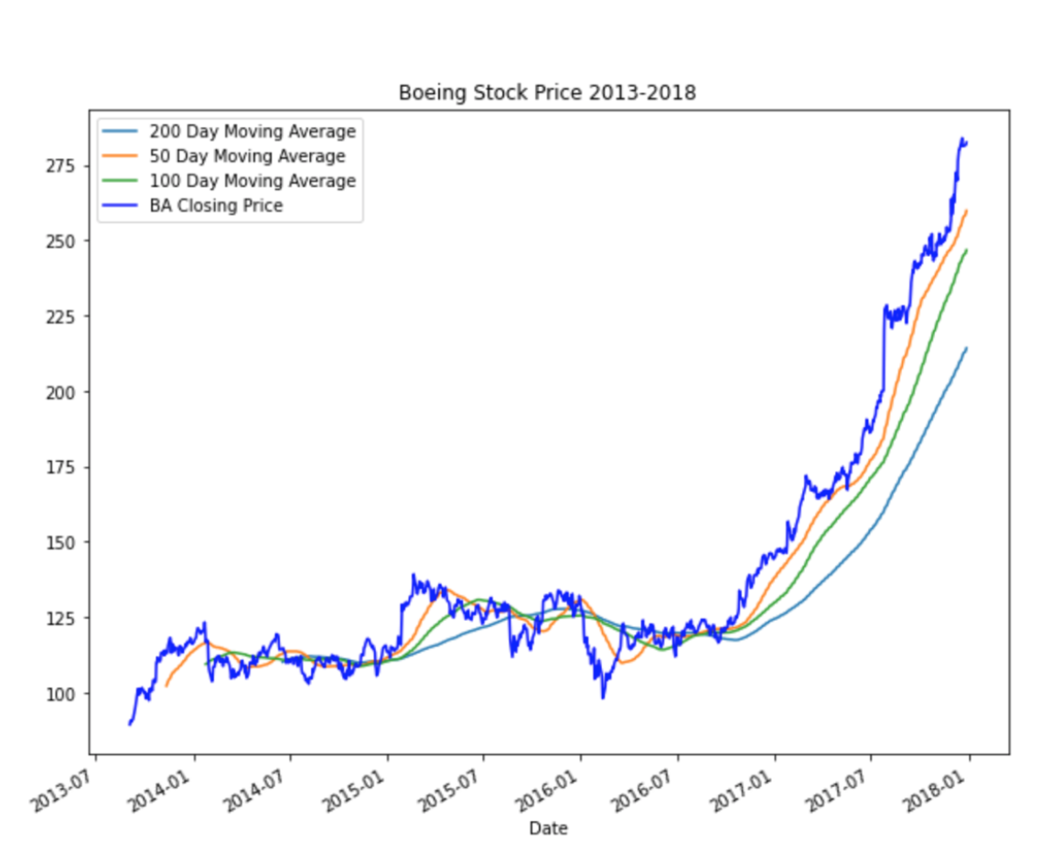
Boeing Stock Price 2013-2017

Slide 6
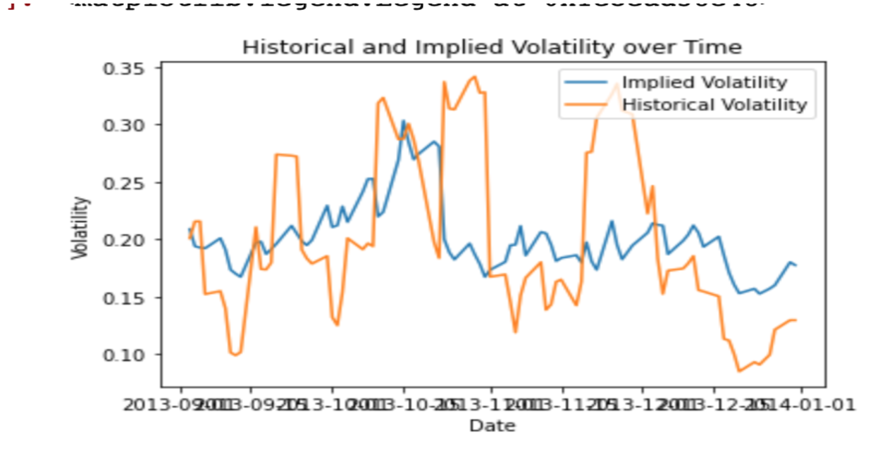
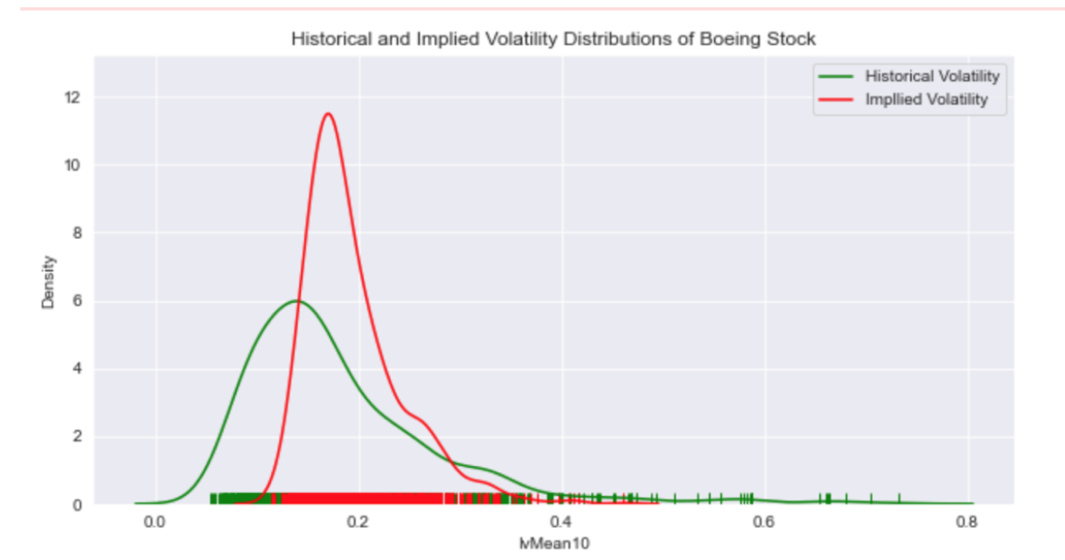
Implied and Historical Volatility

Slide 7
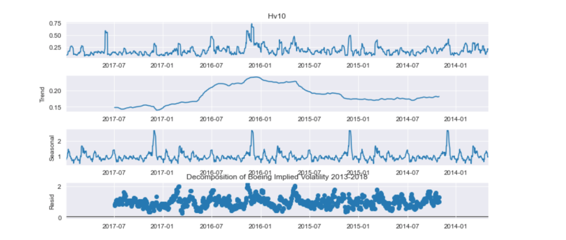
Seasonal Trends

Slide 8
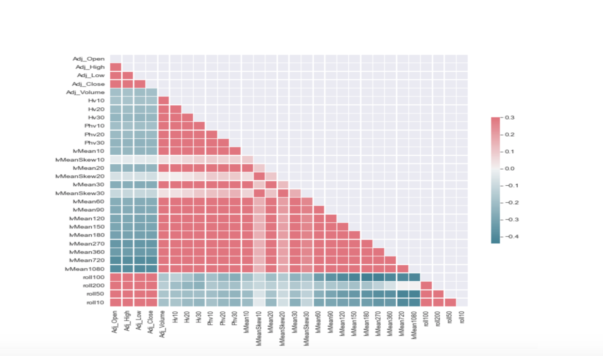
Heatmap Correlations

Slide 9
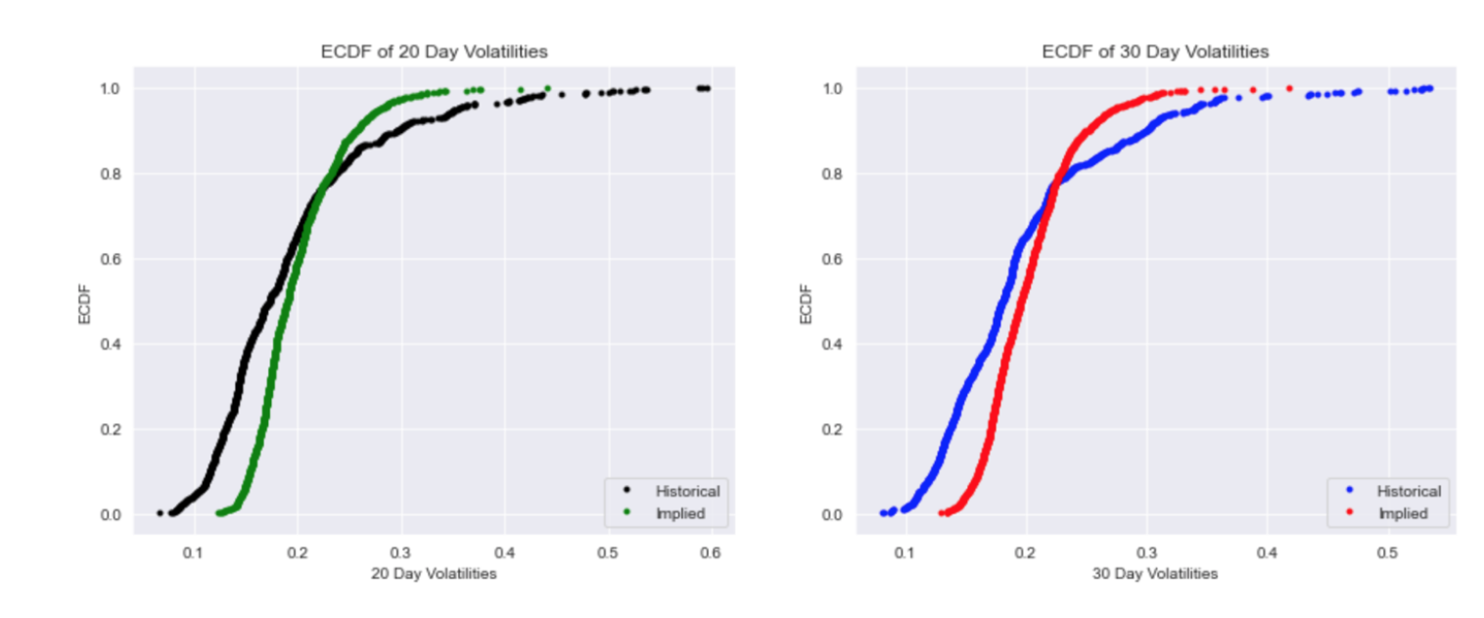
ECDF of 20 and 30 Day Volatilities

Slide 10
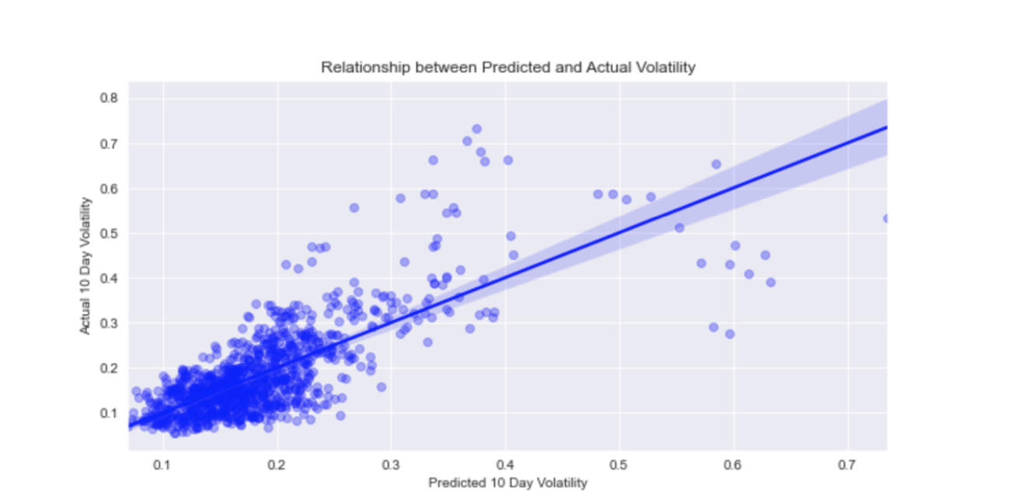
Regression between Predicted and Actual Volatility

Slide 11
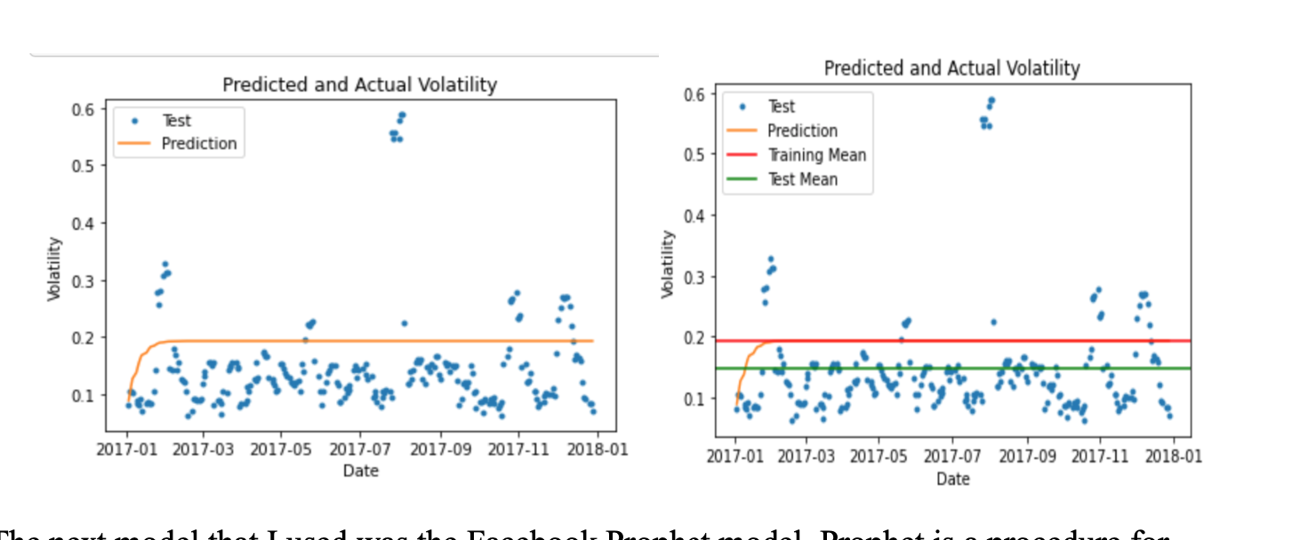
Baseline auto-ARIMA model

Slide 12
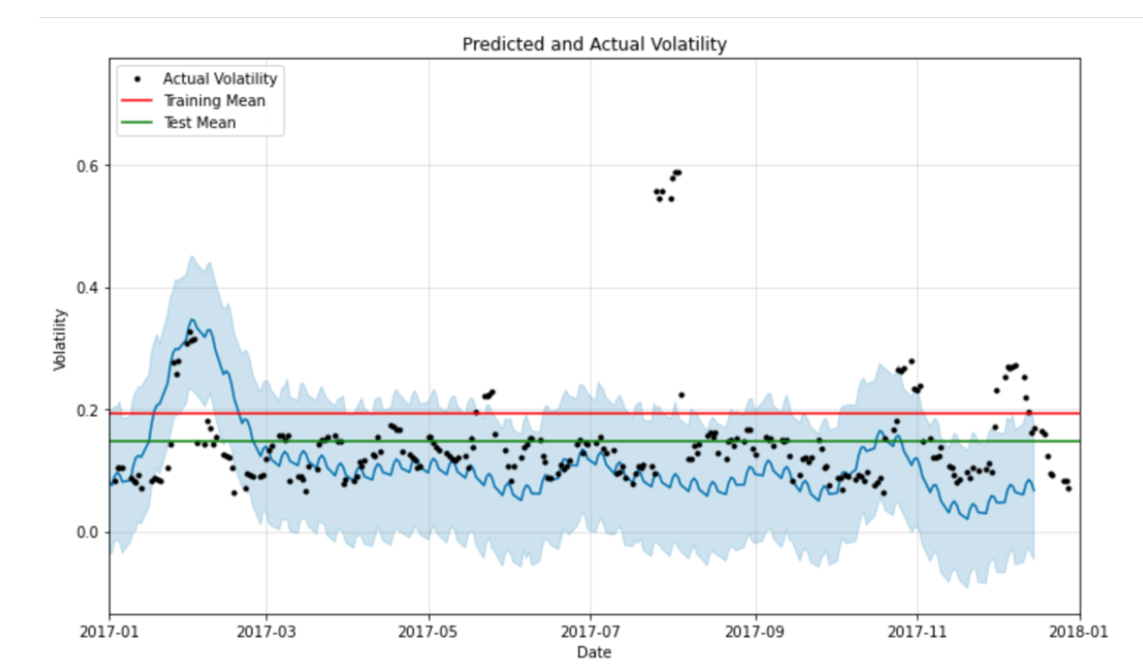
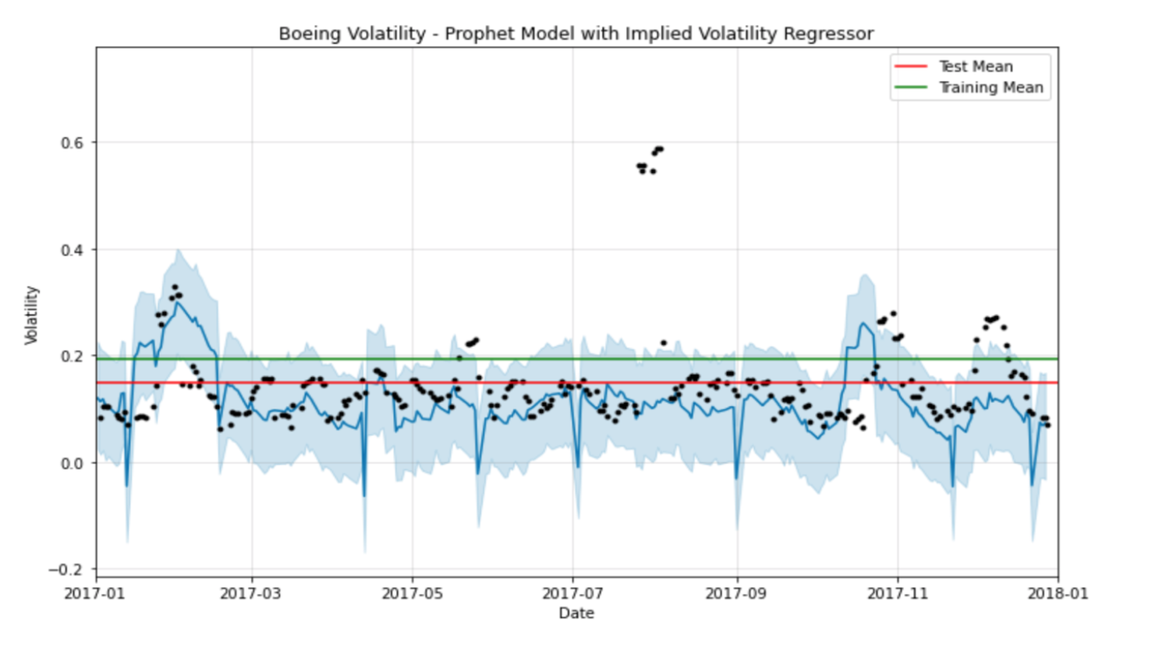
Facebook Prophet Models

Slide 13
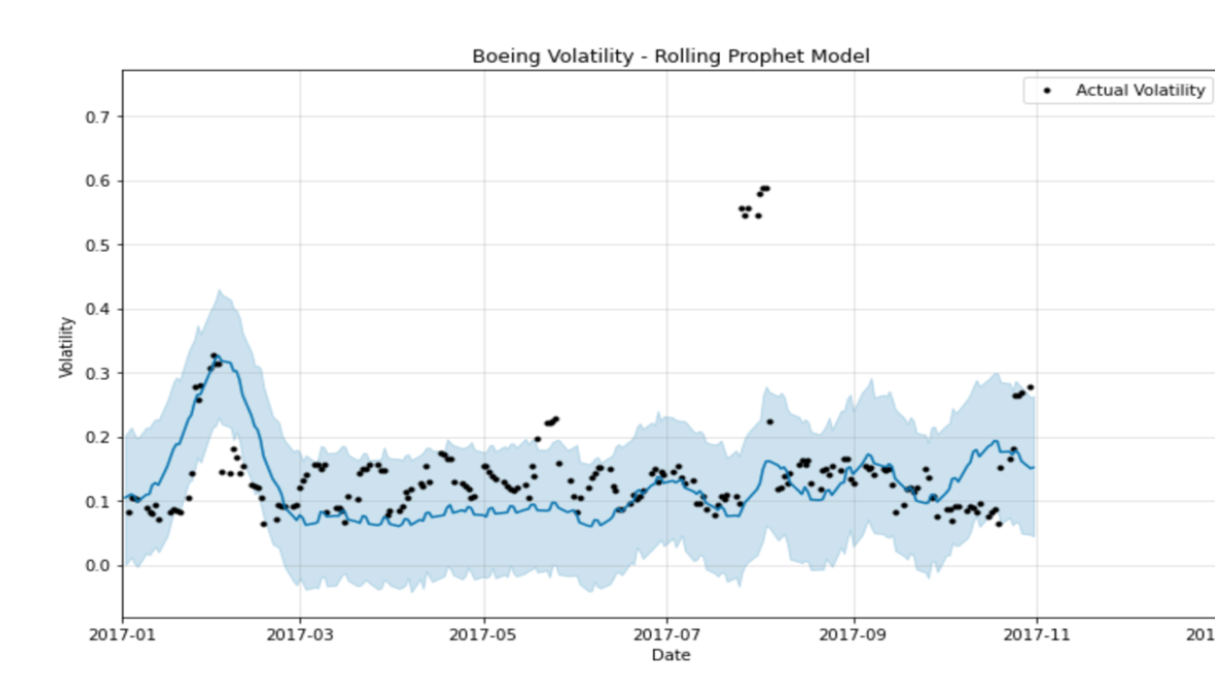
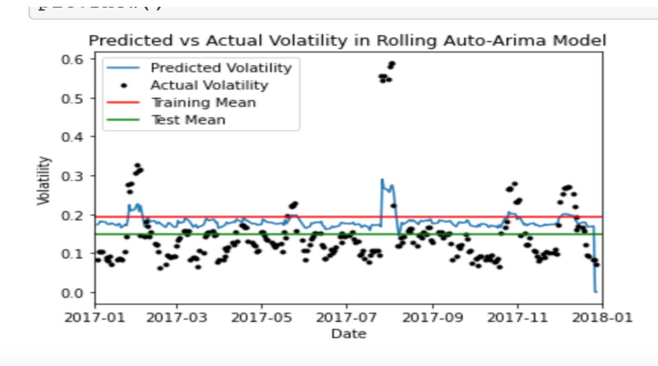
10-Day Rolling Models

Slide 14
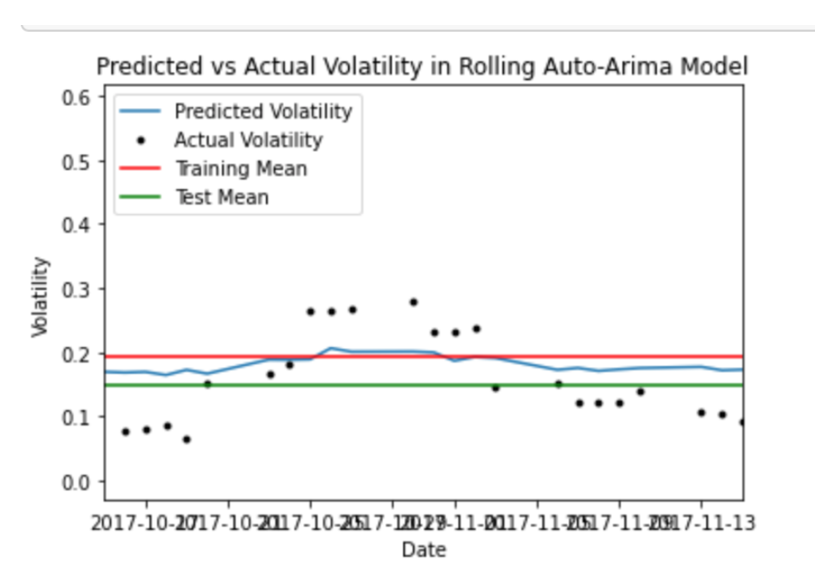
Direction of Volatility in a Year

Slide 15
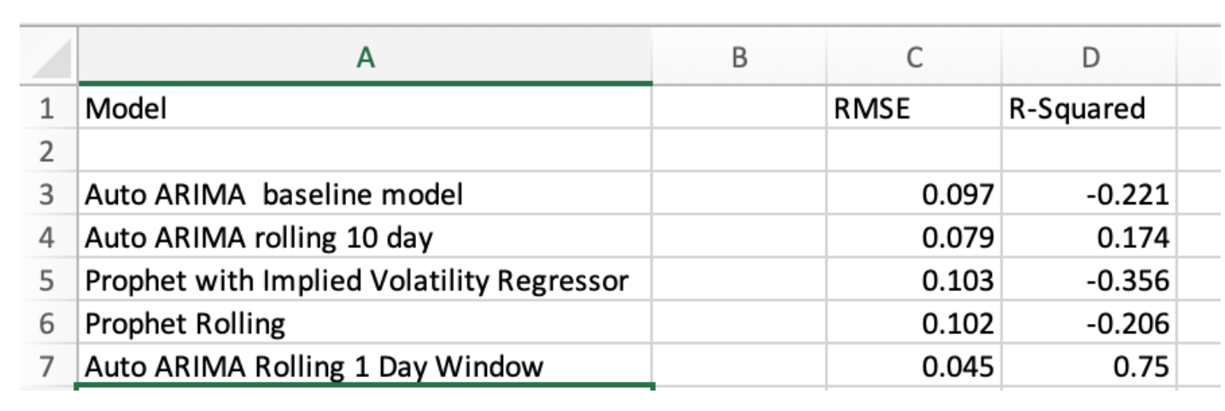
Model Conclusions

Slide 16
Future Work and Recommendations
Add more features to improve the predictive accuracy of forecasts going forward
Apply a different training to test set ratio, a shorter training set could be a better predictor
The model was unable to predict greater accuracy than the mean of test set
However, we were able to make useful insights to where a client can see directions of volatility and seasonal patterns

Slide 17

Thank You!
https://github.com/ejnuss95/Springboard/tree/master/Capstone%20Boeing
https://www.linkedin.com/in/evan-nussbaum-2969b2a8/

